Slide 1
Spring Boot Actuator, Metrics, Profiles

Slide 2

Spring Boot Actuator
Spring Boot Actuator helps you monitor and manage your application by enabling production-ready features without having to implement them yourself.
It provides endpoints for exposing different types of information about the running application, such as health, metrics, info, thread dump, http trace, etc.
Notes:
Primary goal of the “Cloud Native Development” track is to introduce the audience to Spring Boot.

Slide 3

Spring Boot Actuator
Built-in instrumentation for Spring Boot applications
Out-of-the-box endpoints
Customizable health checks
Cloud-friendly HTTP(S) protocol
Secure

Slide 4
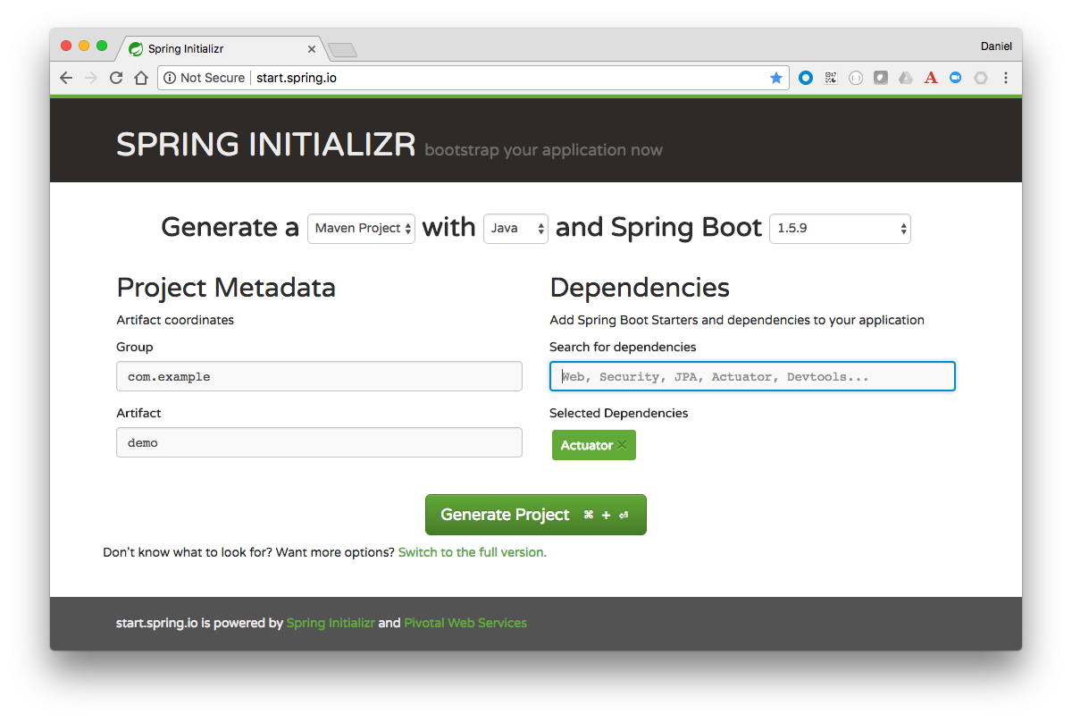
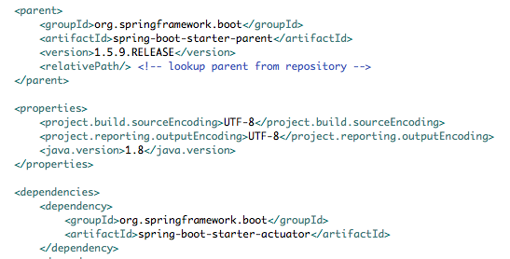
Spring Boot Actuator
Enable by adding dependency to POM file.

Slide 5
Actuator Endpoints | Description
auditevents | Exposes audit events information for the current application.
beans | Displays a complete list of all the Spring beans in your application.
conditions | Shows the conditions that were evaluated on auto-configuration classes and the reasons why they did/didn’t match
configprops | Displays a collated list of all @ConfigurationProperties.
env | Exposes properties from Spring’s ConfigurableEnvironment.
health | Shows application health information.
httptrace | Displays HTTP trace information (by default, the last 100 HTTP request-response exchanges).
info | Displays arbitrary application info.
metrics | Shows ‘metrics’ information for the current application.
mappings | Displays a collated list of all @RequestMapping paths.
threaddump | Performs a thread dump.

Slide 6
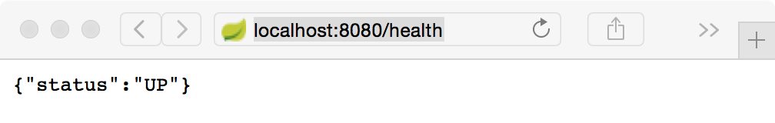
Health Endpoint and Auto-configured HealthIndicators
Name | Description
CassandraHealthIndicator | Checks that a Cassandra database is up.
DiskSpaceHealthIndicator | Checks for low disk space.
DataSourceHealthIndicator | Checks that a connection to DataSource can be obtained
JmsHealthIndicator | Checks that a JMS broker is up.
MailHealthIndicator | Checks that a mail server is up.
MongoHealthIndicator | Checks that a Mongo database is up.
RabbitHealthIndicator | Checks that a Rabbit server is up.
Complete list: https://docs.spring.io/spring-boot/docs/current/reference/html/production-ready-endpoints.html#_auto_configured_healthindicators

Slide 7
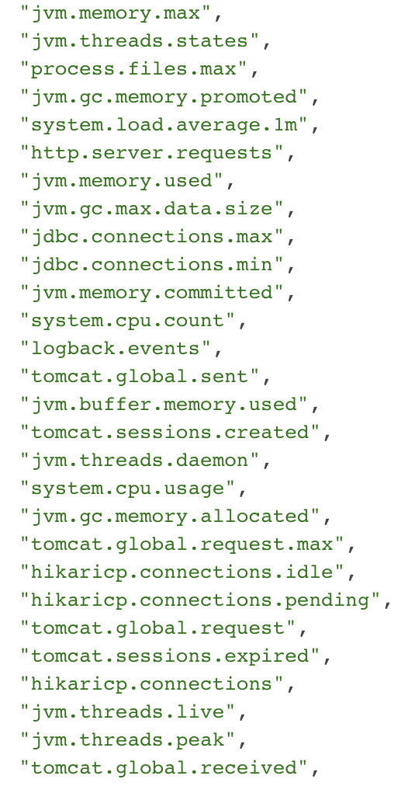
Metrics
Actuator provides dependency management and auto-configuration for Micrometer, an application metrics facade that supports numerous monitoring systems, including: AppOptics, Atlas, Datadog, Dynatrace, Elastic, Ganglia, Graphite, Humio, Influx, JMX, KairosDB, New Relic, Prometheus, SignalFx, Simple (in-memory), StatsD, Wavefront
Spring Boot registers the following core metrics (in addition to others) when applicable:
JVM metrics, report utilization of:
Various memory and buffer pools
Statistics related to garbage collection
Threads utilization
Number of classes loaded/unloaded
CPU metrics
File descriptor metrics
Uptime metrics
Tomcat metrics
Complete details: https://docs.spring.io/spring-boot/docs/current/reference/html/production-ready-metrics.html#production-ready-metrics

Slide 8
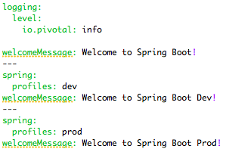

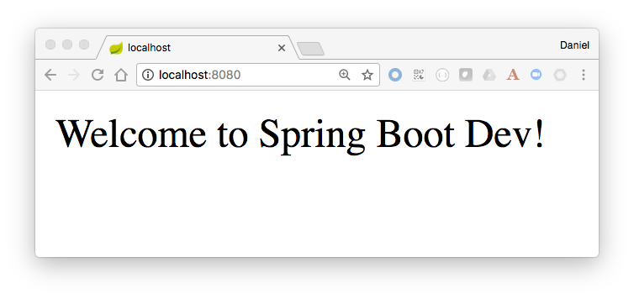
Profiles
YAML file can contain for several documents
Convenient to specify alternate configurations in the same file
Set the active profile:
SPRING_PROFILES_ACTIVE=production
OR
spring.profiles.active=production

Slide 9
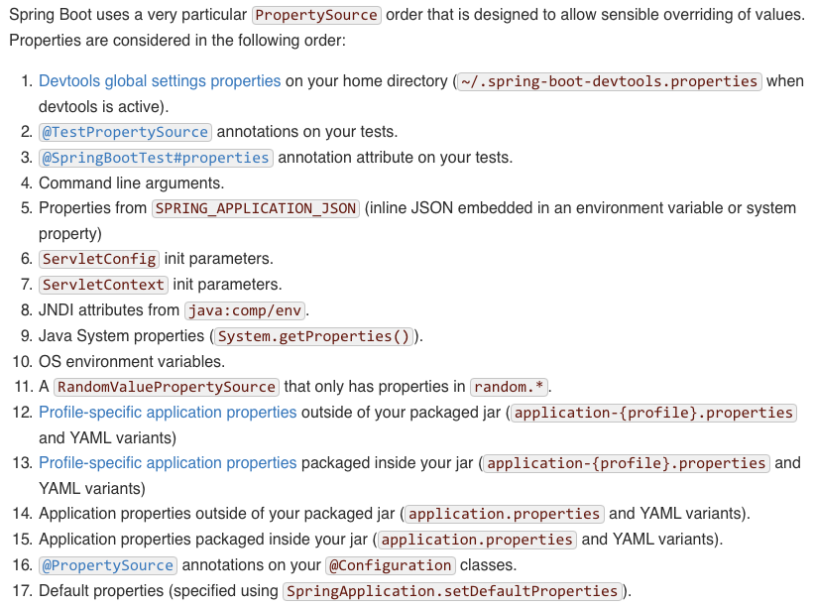
Externalized Configuration
Automatically extract application properties from different sources
Well-defined hierarchy
https://docs.spring.io/spring-boot/docs/current/reference/html/boot-features-external-config.html
Facilitates multiple testing environments
eg. promoting code from local → dev → test → prod
Spring Cloud Config Server

Slide 10

Transforming How The World Builds Software
© Copyright 2017 Pivotal Software, Inc. All rights Reserved.

